Slide 1
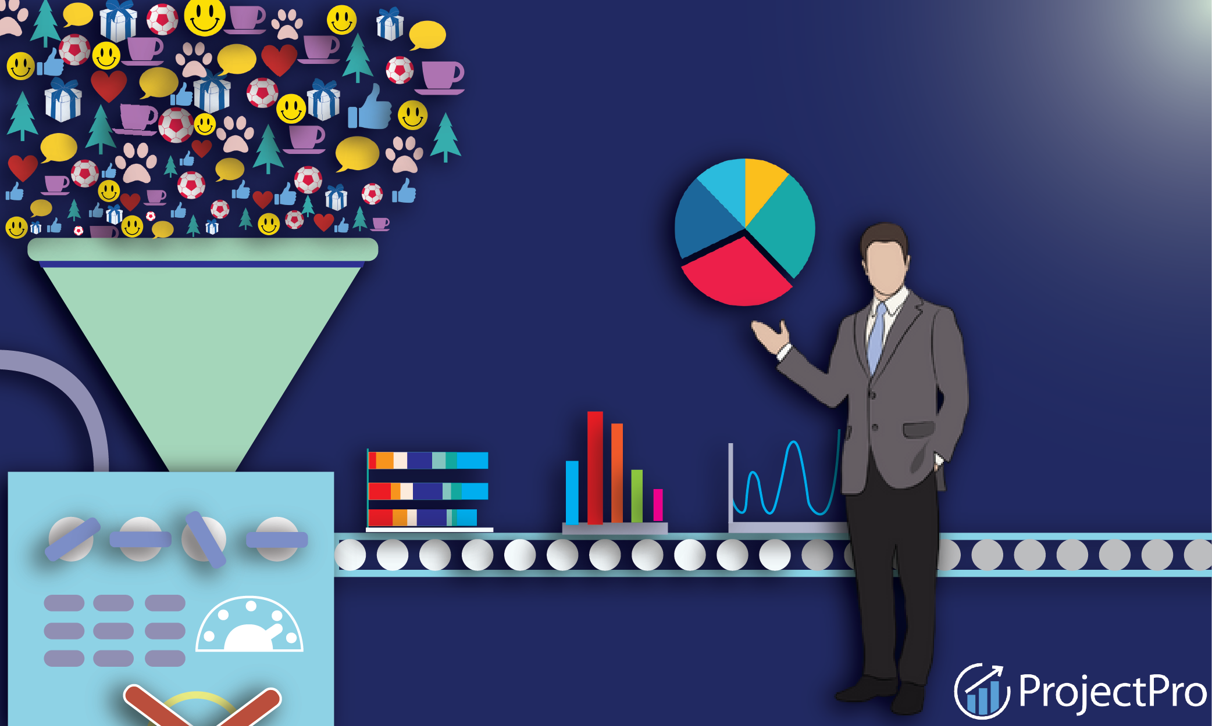
Transforming EKK into a Data Driven Powerhouse
PRATIK Chatterjee- Data Scientist

Slide 2
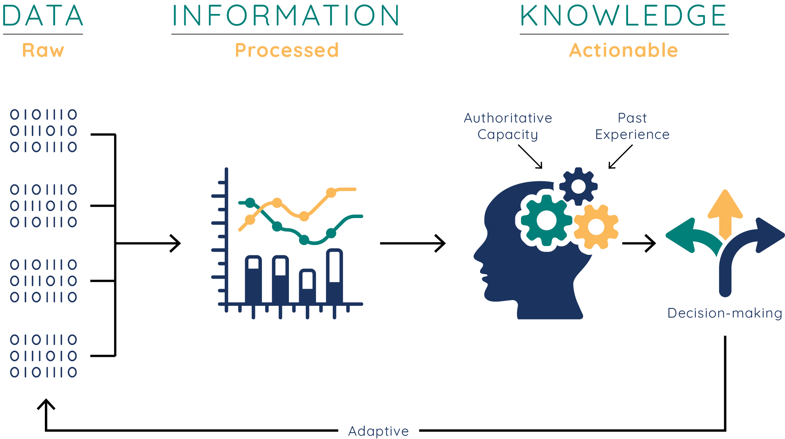
What is Data?
What we do with data is the value realization!

Slide 3
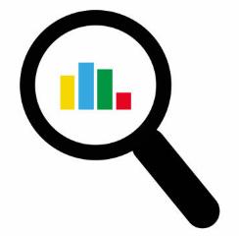
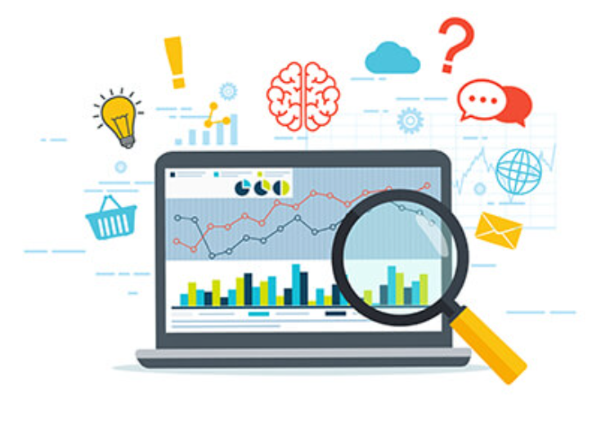

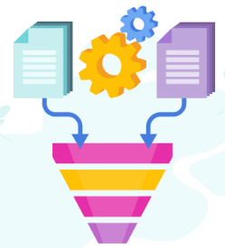
Big Data Analytics Vision and Strategy
Vision:
Become a leader in utilizing data analytics to drive business decisions, creating value for customers and stakeholders.
Strategy:
Ensure comprehensive, accurate, and real-time data collection across the organization. Automate processes at every level to improve efficiency.
Create a unified data platform to integrate disparate data sources.
Analysis & Insights: Use advanced analytics tools and methodologies to extract actionable insights.
Embed analytics in decision-making processes across departments
Data Collection
Integration
Analysis & Insights
Decision-making

Slide 4
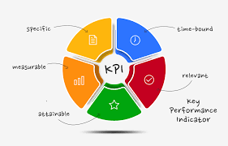
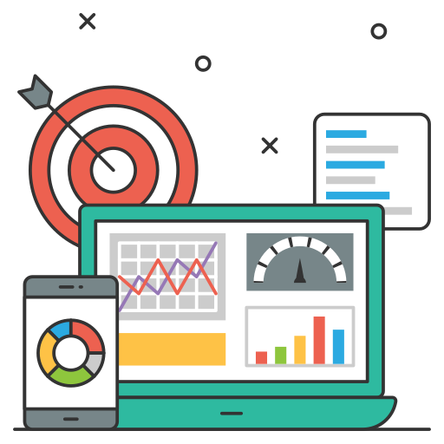
Recommended Approach on Development and Delivery of Analytics Streams
Development:
Identify Key Performance Indicators (KPIs).
Gather & clean data relevant to KPIs.
Employ descriptive, diagnostic, predictive, and prescriptive analytics techniques.
Deliver:
Use data visualization tools to create dashboards for real-time decision-making.
Regular training sessions for staff to understand and act on the insights.
Example: Like predicting sales trends in Q4 based on historical data.

Slide 5
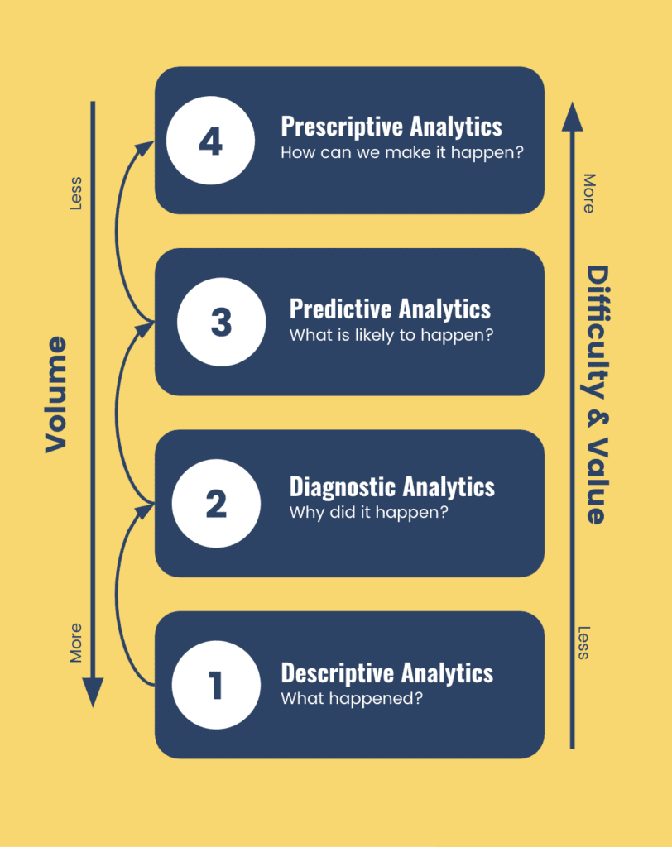
The Analytical Framework
Descriptive Analytics: Understand the past and current business scenarios using statistical techniques.
Diagnostic Analytics: examines data to answer the question "Why did it happen?". It is used to determine the cause of a particular event or series of events.
Predictive Analytics: Forecast future trends by deploying machine learning models. For instance, regression models for sales forecasts or clustering for market segmentation.
Prescriptive Analytics: Recommend the best actions based on data predictions. This can be achieved using optimization algorithms or recommendation engines

Slide 6
Target Architecture Overview including end to end data flow
5
Dashboards, Reports, Automated Systems.
1.Sources
3. Data Warehouse
4. Analytics Layer
2. Data Integration Layer
5. Output
4
Tools and software to analyze the data.
3
Central repository for integrated data.
2
ETL (Extract, Transform, Load) processes to collect and clean data.
1
CRM, ERP, Website, Social Media, IoT devices, etc.

Slide 7







Proposed Analytical Solution for the Rollout
Data Lake and Warehouse: A scalable storage solution to keep raw data (data lake) and structured, processed data
Example: Storing raw logs of car usage in the Data Lake and summarized daily statistics in the Data Warehouse.
Machine Learning and AI: Tools and platform for building, training, and deploying models.
Example: A machine learning model predicting a car’s service needs based on usage pattern.
Platform:
Using a platform like Tableau or Power BI for visualization and initial analysis.
Advanced Analysis:
Tools like Python or R for deeper, more complex analysis.
Infrastructure:
Cloud-based solutions (e.g., AWS, Google Cloud) for scalability and flexibility.

Slide 8
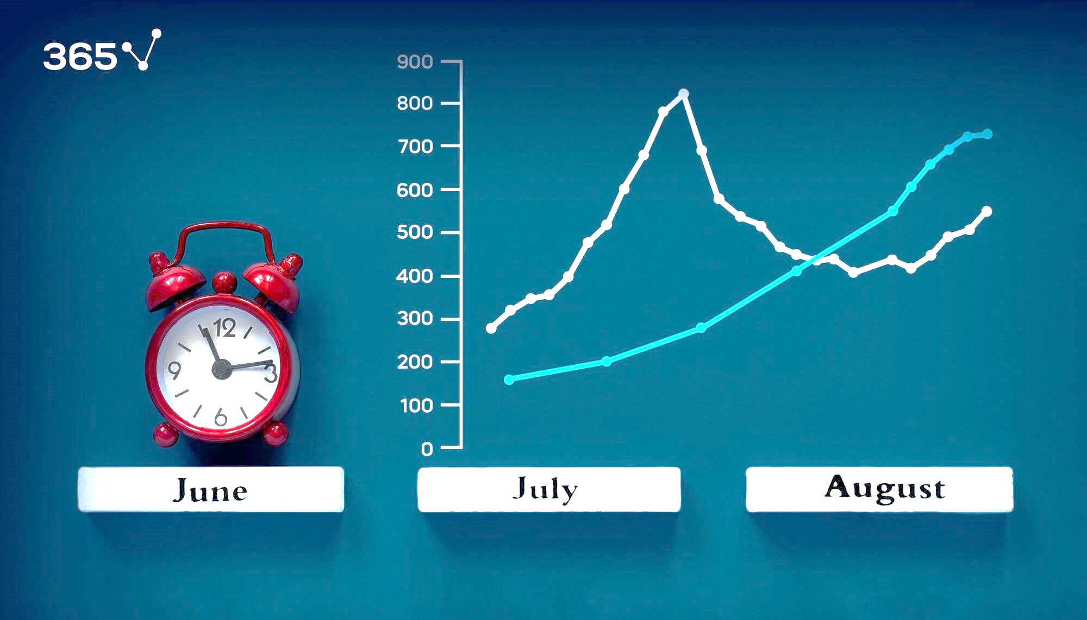
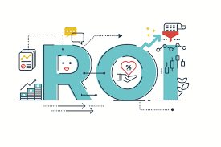
Define Use Case Prioritization Framework and Analytical Models
Framework:
Impact on Business (High, Medium, Low)
Feasibility (Technical and Operational)
ROI (Return on Investment)
Analytical Models:
Regression, Clustering, Time Series Forecasting, Decision Trees, Neural Networks based on use case.
Example: Determine the impact of a marketing campaign on customer acquisition- High impact, Technically feasible and High ROI.

Slide 9
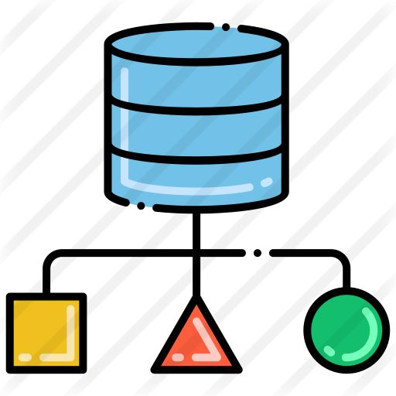
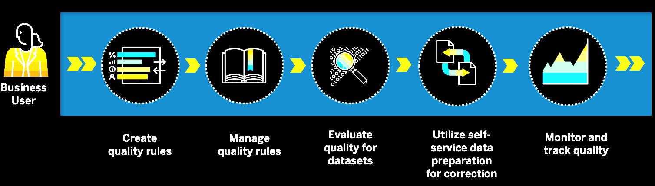
Define Data Modeling & Data Quality Business Rules
Data Modeling:
ER Diagrams, Star Schema or Snowflake Schema based on the complexity of data relationships.
Data Quality Rules:
Completeness: No missing values.
Consistency: Standardized formats.
Accuracy: Verification against trusted sources.
Timeliness: Updated at defined intervals.
Relevance: Only meaningful data is stored.

Slide 10
Implementation Roadmap defining milestones and calendar
Phase 1
Phase 2
Phase 3
Phase 4
[1- 3 Months]
Data Collection & Infrastructure Setup.
[4- 6 Months] Analytics Integration & Initial Dashboard
[7- 9 Months] Advanced Analysis & Implementation of Insights in Decision-making.
[10- 12 Months] Review, Feedback, and Iteration for Continuous Improvement
** By Month 6, we’ll be making our first data- driven changes

Slide 11
THANK YOU!
“Information is the oil of the 21st century, and analytics is the combustion engine.”
- Peter Sondergaard, Gartner Research

